Slide 1
IPV4
ADITYA KUMAR MOHANTY
M.TECH(CSE) 2ND SEM
2022108

Slide 2

Content
What is ip?
Ipv4
Subnetting
Supernetting
Problem
Recovery algo
Reference

Slide 3
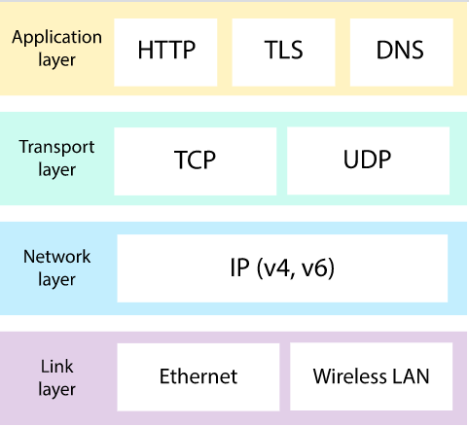
What is INTERNET PROTOCOL
The Internet Protocol (IP) is the principal communications protocol in the Internet protocol suite for relaying datagrams across network boundaries.
• The Internet protocol suite therefore often referred to as TCP/IP.
• The first major version of IP, Internet Protocol Version 4 (IPv4), is the dominant protocol of the Internet. Its successor is Internet Protocol Version 6 (IPv6).

Slide 4

How Do You Get IPs?
IP address ranges controlled by IANA
Internet Assigned Number Authority
Today, part of ICANN
IANA grants IPs to regional authorities
ARIN (American Registry of Internet Numbers) may grant you a range of IPs
You may then advertise routes to your new IP range
There are now secondary markets, auctions, …

Slide 5
IPv4
Internet Protocol version 4 (IPv4) is the fourth version in the development of the Internet Protocol (IP) Internet, and routes most traffic on the Internet .
IPv4 is a connectionless protocol for use on packet-switched networks.
It operates on a best effort delivery model, in that it does not guarantee delivery, nor does it assure proper sequencing or avoidance of duplicate delivery.
In 1978, the Office of the Secretary of Defence (OSD) mandated the use of IPv4 for all "host-to-host" data exchange enabling IPv4 to become the mechanism for the military to create integrated versus stove piped communications.

Slide 6
IPv4 Addresses.
An IPv4 address is a 32-bit address that uniquely and universally defines the connection of a device (for example, a computer or a router) to the Internet.
The IPv4 addresses are unique and universal.
They are unique in the sense that each address defines one, and only one, connection to the Internet.
The IPv4 addresses are universal in the sense that the addressing system must be accepted by any host that wants to be connected to the Internet.

Slide 7
Address Space.
An address space is the total number of addresses used by the protocol.
If a protocol uses N bits to define an address, the address space is 2N because each bit can have two different values (0 or 1) and N bits can have 2N values.
IPv4 uses 32-bit addresses, which means that the address space is 2^32 or 4,294,967,296 .
This means that, theoretically, if there were no restrictions, more than 4 billion devices could be connected to the Internet.

Slide 8
Notation
There are two prevalent notations to show an IPv4 address:
binary notation
dotted-decimal notation.
Binary Notation –
In binary notation, the IPv4 address is displayed as 32 bits.
Each octet is often referred to as a byte.
The following is an example of an IPv4 address in binary notation: 01110101 10010101 00011101 00000010

Slide 9
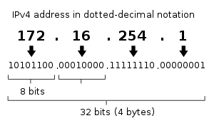
Cont.
Dot-Decimal Notation-
Dot-decimal notation is a presentation format for numerical data.

Slide 10
Hexadecimal Notation
0111 0101 1001 0101 0001 1101 1110 1010
75 95 1D EA
0x75951DEA

Slide 11
Rules for Ipv4 notations
There must be no leading zero .
There can be no more than four numbers in an IPv4 address.
Each number needs to be less than or equal to 255 .
A mixture of binary notation and dotted-decimal notation is not allowed.

Slide 12
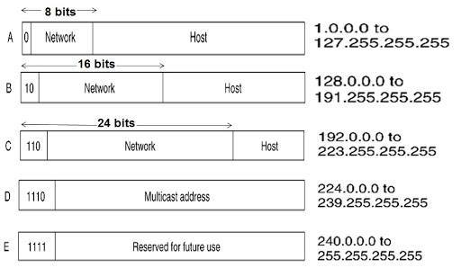
Classful Addressing
IPv4 addressing, at its inception, used the concept of classes. This architecture is called classful addressing.
• In classful addressing, the address space is divided into five classes: A, B, C, D, and E.
• Each class occupies some part of the address space is called classful addressing.

Slide 13
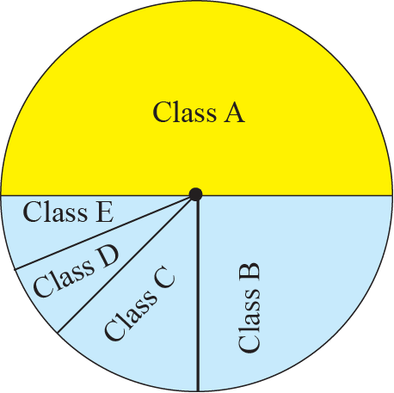
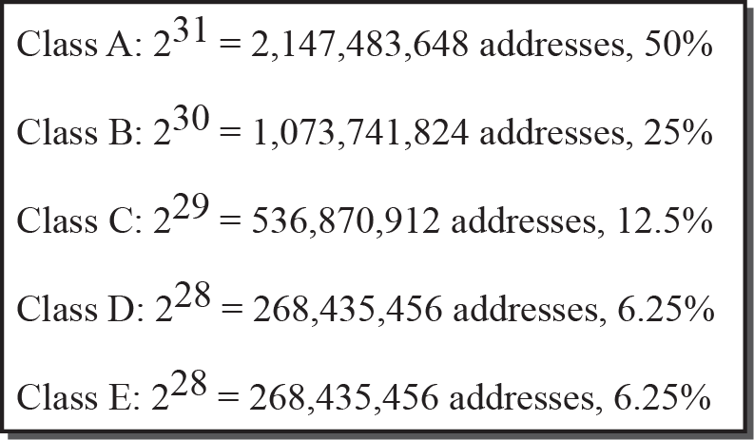
Example
Find the class of each address.
a. 00000001 00001011 00001011 11101111
b. 11000001 10000011 00011011 11111111
c. 14.23.120.8
d. 252.5.15.111
Solution
a. The first bit is O. This is a class A address.
b. The first 2 bits are 1; the third bit is O. This is a class C address.
c. The first byte is 14 (between 0 and 127); the class is A.
d. The first byte is 252 (between 240 and 255); the class is E.

Slide 14
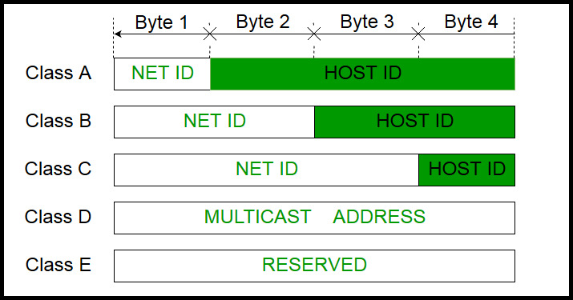
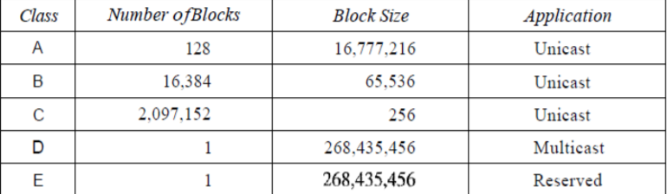
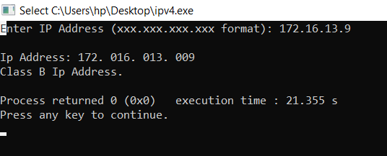
implementation

Slide 15
explanation
A block in class A address is too large for almost any organization. This means most of the addresses in class A were wasted and were not used.
A block in class B is also very large, probably too large for many of the organizations that received a class B block.
A block in class C is probably too small for many organizations.
Class D addresses were designed for multicasting.
The class E addresses were reserved for future use ; only a few were used, resulting in waste of addresses.

Slide 16
Cont.
Netid and Hostid
In classful addressing, an IP address in class A, B, or C is divided into netid and hostid.
These parts are of varying lengths, depending on the class of the address.
In class A, one byte defines the netid and three bytes define the hostid.
In class B, two bytes define the netid and two bytes define the hostid.
In class C, three bytes define the netid and one byte defines the hostid.

Slide 17
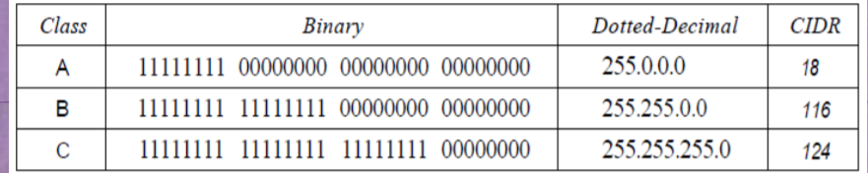
Mask
Although the length of the netid and hostid (in bits) is predetermined in classful addressing, we can also use a mask (also called the default mask), a 32-bit number made of contiguous 1s followed by contiguous 0s.
The concept does not apply to classes D and E.
The mask can help us to find the netid and the hostid. For example, the mask for a class A address has eight 1s, which means the first 8 bits of any address in class A define the netid; the next 24 bits define the hostid.
The last column of Table shows the mask in the form /n where n can be 8, 16, or 24 in classful addressing. This notation is also called slash notation or Classless Interdomain Routing (CIDR) notation.

Slide 18
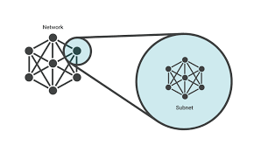
Subnetting
During the era of classful addressing, subnetting was introduced.
• If an organization was granted a large block in class A or B, it could divide the addresses into several contiguous groups and assign each group to smaller networks (called subnets).
• Or, in rare cases, share part of the addresses with neighbours.
• Subnetting increases the number of 1s in the mask.

Slide 19
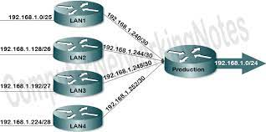
Super netting
In supernetting, an organization can combine several class C blocks to create a larger range of addresses.
In other words, several networks are combined to create a supernetwork or a supemet .
An organization can apply for a set of class C blocks instead of just one.
- For example, an organization that needs 1000 addresses can be granted four contiguous class C blocks.
The organization can then use these addresses to create one supernetwork.
Supernetting decreases the number of 1s in the mask.

Slide 20
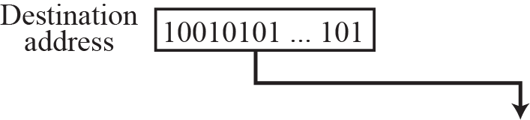
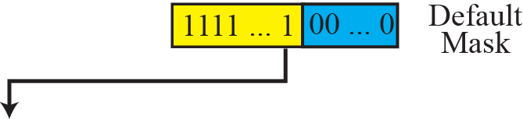
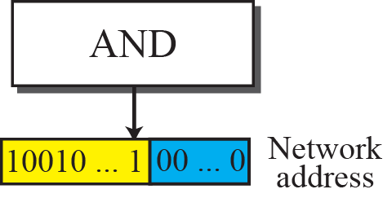
Finding a Network Address using the Default Mask

Slide 21
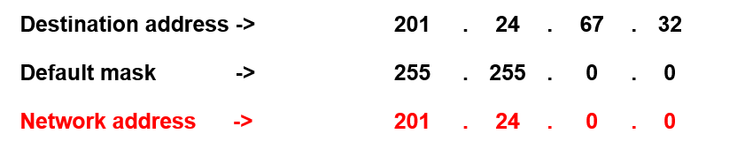
Example
A router receives a packet with the destination address 201.24.67.32. Show how the router finds the network address of the packet.
Solution
Since the class of the address is B, we assume that the router applies the default mask for class B, 255.255.0.0 to find the network address.

Slide 22
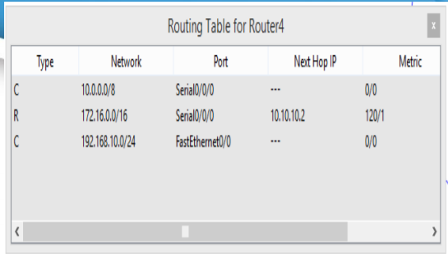
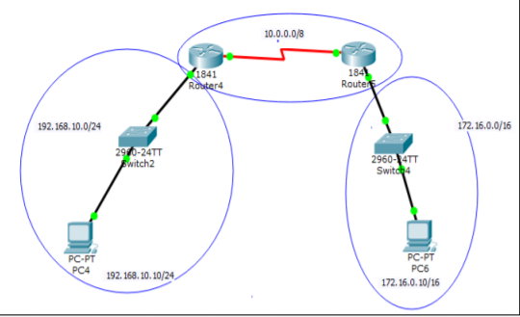
Ipv4 routing

Slide 23
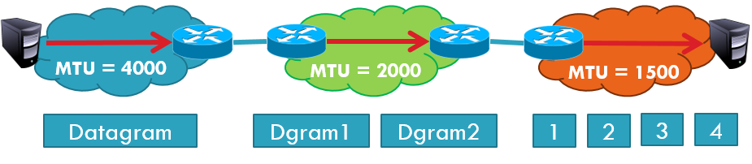
Problem: Fragmentation
Problem: each network has its own MTU
DARPA principles: networks allowed to be heterogeneous
Minimum MTU may not be known for a given path
IP Solution: fragmentation
Split datagrams into pieces when MTU is reduced
Reassemble original datagram at the receiver

Slide 24
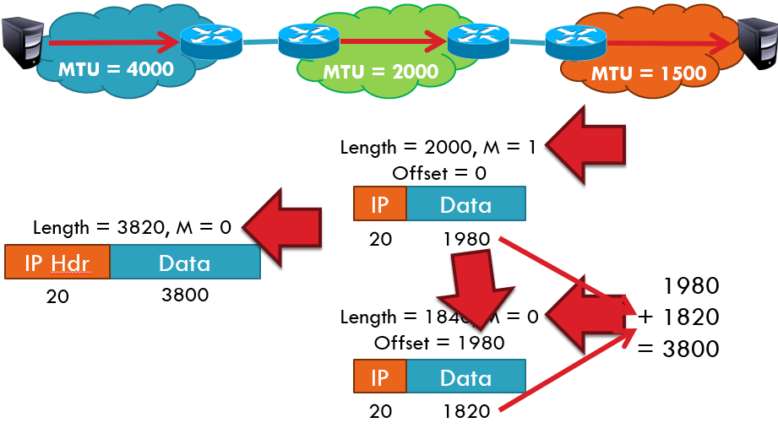
Fragmentation Example

Slide 25
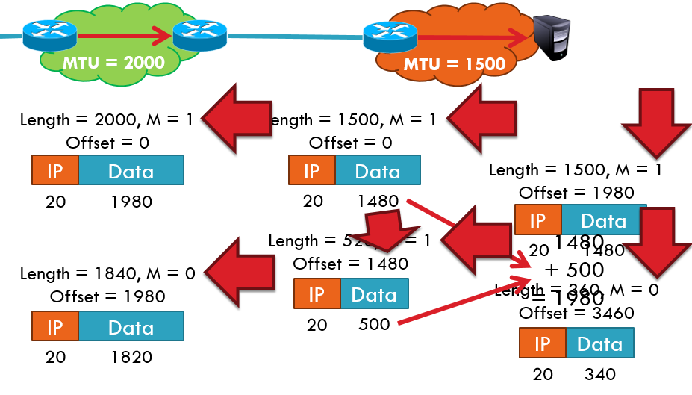
Cont.

Slide 26
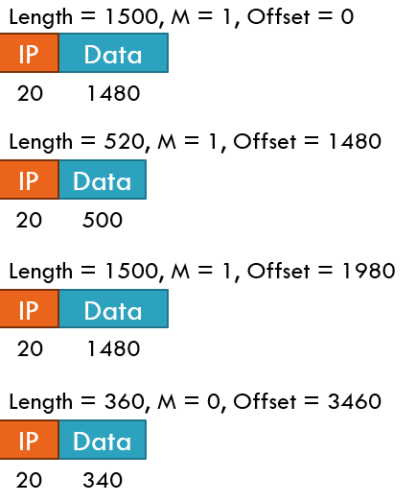
IP Fragment Reassembly
Performed at destination
M = 0 fragment gives us total data size
360 – 20 + 3460 = 3800
Challenges:
Out-of-order fragments
Duplicate fragments
Missing fragments

Slide 27
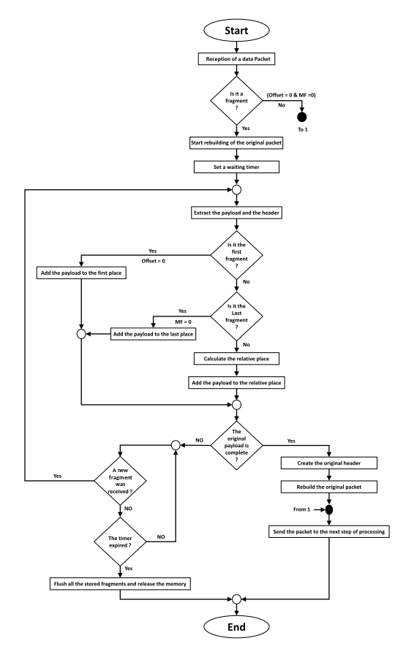
Algo.

Slide 28
reference
https://en.wikipedia.org/wiki/IPv4
https://www.riverpublishers.com/journal/journal_articles/RP_Journal_2245-800X_714.pdf
https://www.geeksforgeeks.org/what-is-ipv4/
https://www.slideshare.net/sonaltelang/ipv4-ppt

Slide 29
Thank you…

